Slide 1
Nature Inspired Algorithm
Kella Khushbu (17BIT037)
Guided by –Prof. Ajay Patel

Slide 2
Abstract
To solve NP hard and complex problem
A list of automated toolboxes available for directly evaluating these nature inspired algorithms.
based on physics and biology approaches and algorithm.
This presentation includes ACO,PSO,CS,ABC Algorithm. Classification of NIA and ANT

Slide 3
Introduction
Nature inspired computing is a technique that is inspired by processes.
As the world is moving towards industrialization, engineering problems are becoming more and more complex and difficult to optimize. This is because of increasing dimensions, variables, time complexity, space complexity etc. To cope up with such situation, nature inspired algorithms are designed to optimize numerical function ,multi objective functions.

Slide 4
Introduction
Nature inspired algorithms such as Swarm-Intelligence and Bio-Inspired are intelligent because by observing their previous moves they improve their performances.
As there is no earnest that result can be obtained, thus we use optimization tools to acquire optimal solution. By using various optimization techniques we can solve many problems by trials and errors.
Due to high efficiency of new emerging algorithms namely particle swarm optimization, cuckoo search and firefly algorithm have been accepted.
Nature plays an important role in different human activities as well as it is ample source of inspiration.Therefore, algorithms based on nature are called Nature Inspired Algorithms (NIAs).

Slide 5
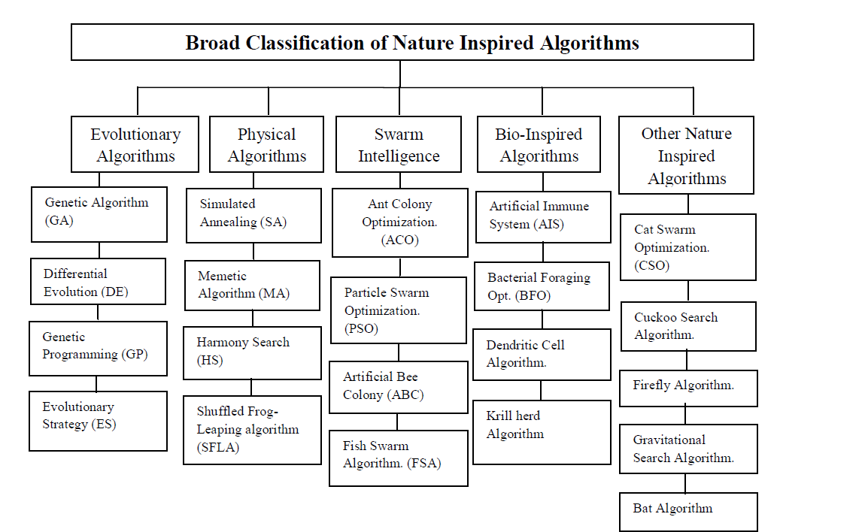
Classification Of NIA

Slide 6
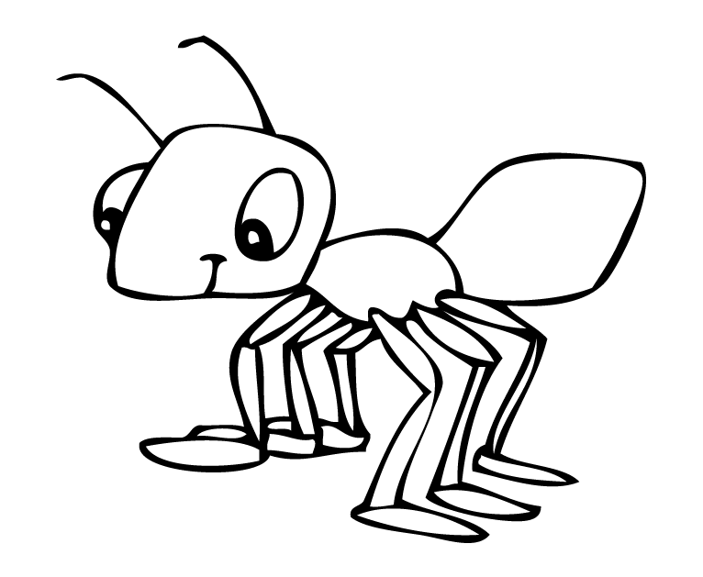
ANT COLONY

Slide 7
Introduction
ACO is a probabilistic technique for solving problems which can be reduced to finding good paths through graphs.
The original idea has since diversified to solve a wider class of numerical problems.
Ad-Hoc implies that the network does not depend on any pre-existing infrastructure such as routers.(MTPR)
THE WHOLE CONCEPT OF ANT COLONY OPTIMIZATION IS TO MINIMIZE THE PATH AND POWER CONSUMPTION.

Slide 8
Emergent Problem Solving in Lasius Niger ants
For Lasius Niger ants, [Franks] observed:
regulation of nest temperature within 1 degree celsius range;
forming bridges
raiding specific areas for food;
building and protecting nest;
sorting brood and food items;
cooperating in carrying large items;
emigration of a colony;
finding shortest route from nest to food source;
preferentially exploiting the richest food source available.
These are swarm behaviours – beyond what any individual can do.

Slide 9
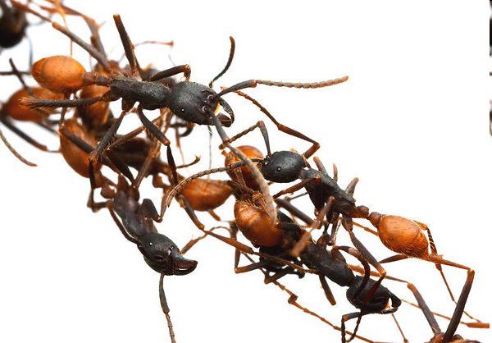

Slide 10
ACO
“Ant Colony Optimization (ACO) studies artificial systems that take inspiration from the behavior of real ant colonies and which are used to solve discrete optimization problems.”

Slide 11
History
Ant System was developed by Marco Dorigo (Italy) in his PhD thesis in 1992.
Max-Min Ant System developed by Hoos and Stützle in 1996.
Ant Colony was developed by Gambardella Dorigo in 1997
Elitist ant system(EAS)
Rank-based ant system (ASrank)
Ant Colony Optimization with Fuzzy Logic(ACO WITH FUZZY)

Slide 12
Pheromone
In the real world, ants (initially) wander randomly, and upon finding food return to their colony while laying down pheromone trails. If other ants find such a path, they are likely not to keep traveling at random, but instead follow the trail laid by earlier ants, returning and reinforcing it if they eventually find food
Over time, however, the pheromone trail starts to evaporate, thus reducing its attractive strength. The more time it takes for an ant to travel down the path and back again, the more time the pheromones have to evaporate.
A short path, by comparison, gets marched over faster, and thus the pheromone density remains high Pheromone evaporation has also the advantage of avoiding the convergence to a locally optimal solution.
If there were no evaporation at all, the paths chosen by the first ants would tend to be excessively attractive to the following ones. In that case,
the exploration of the solution space would be constrained.

Slide 13
Thus, when one ant finds a good (short) path from the colony to a food source, other ants are more likely to follow that path, and such positive feedback eventually leaves all the ants following a single path.
The idea of the ant colony algorithm is to mimic this behavior with "simulated ants" walking around the search space representing the problem to be solved.
Ant colony optimization algorithms have been used to produce near-optimal solutions to the traveling salesman problem.
They have an advantage over simulated annealing and genetic
algorithm approaches when the graph may change dynamically.
The ant colony algorithm can be run continuously and can adapt
to changes in real time.
This is of interest in network routing and urban transportation
systems.

Slide 14
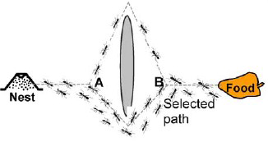
Shortest route is found using pheromone trails which ants deposit whenever they travel, as a form of indirect communication.

Slide 15
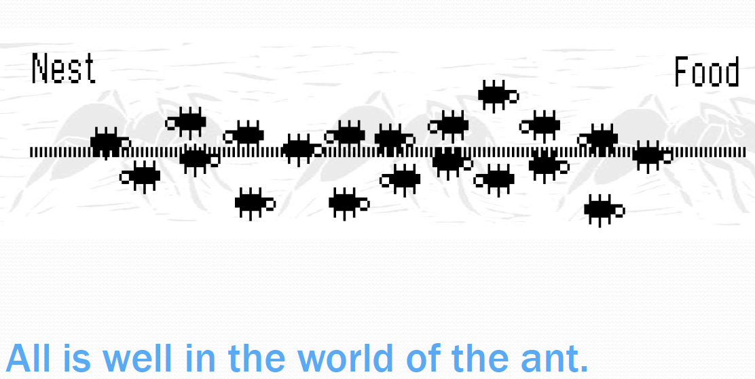
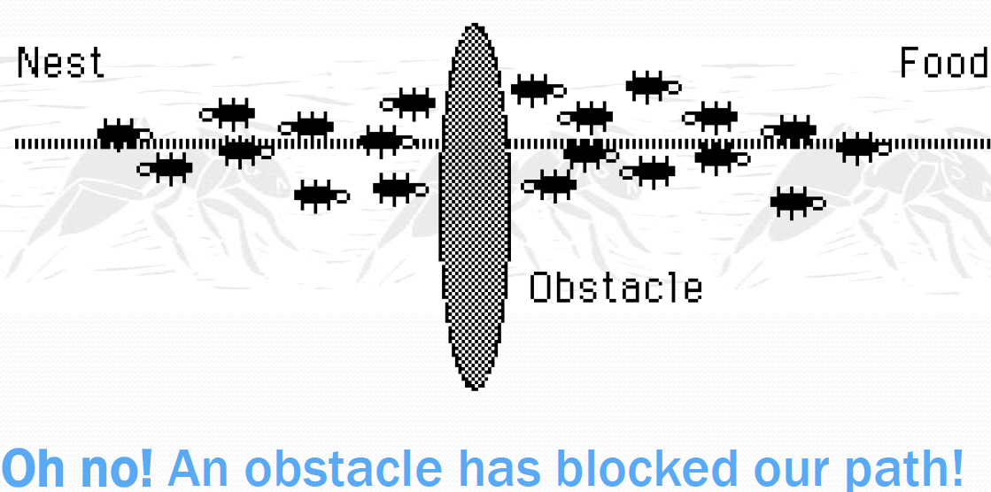
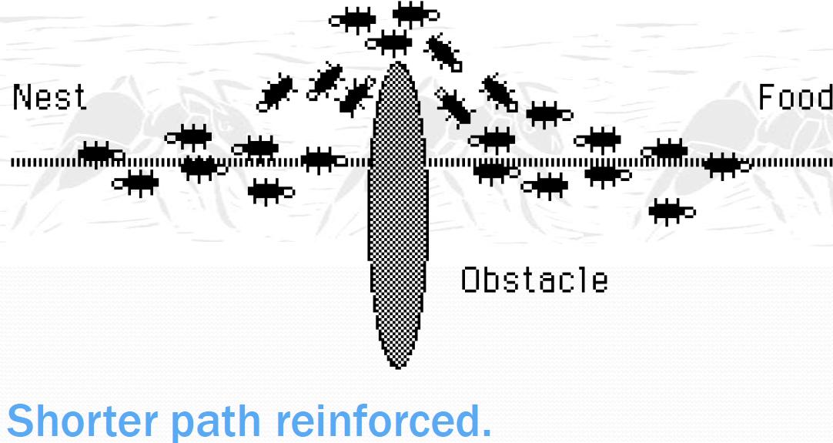
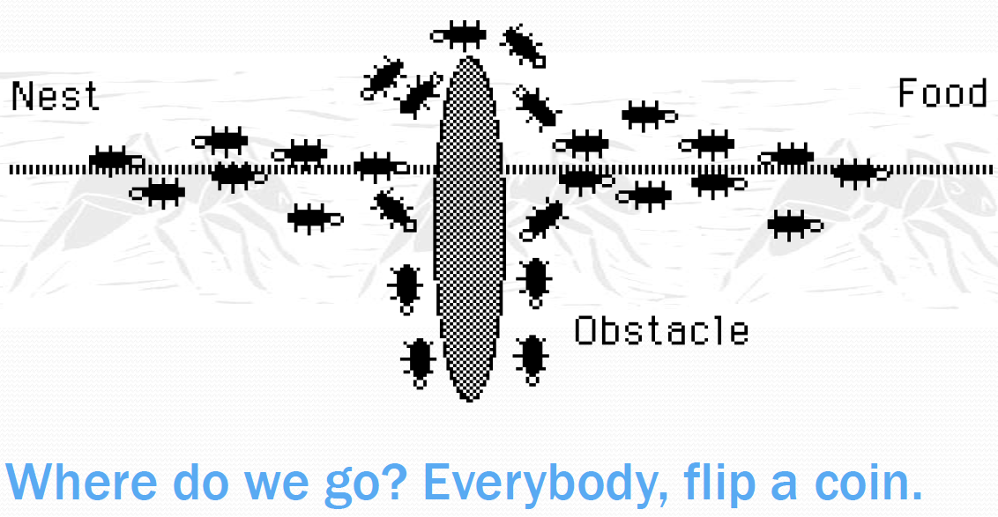

Slide 16
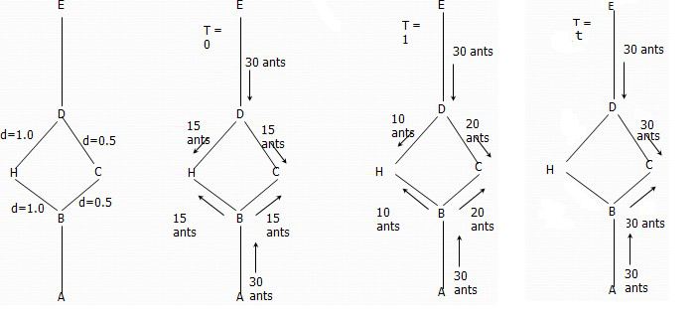
Pheromone Trails: Example

Slide 17
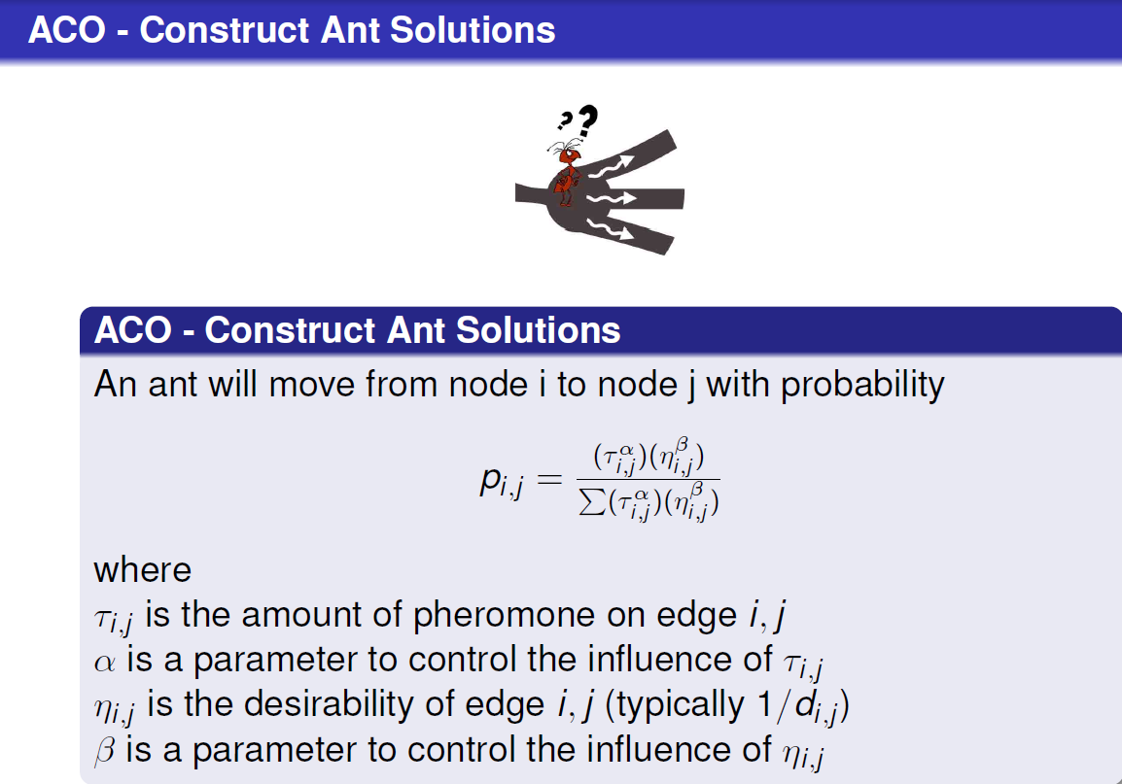
ACO

Slide 18
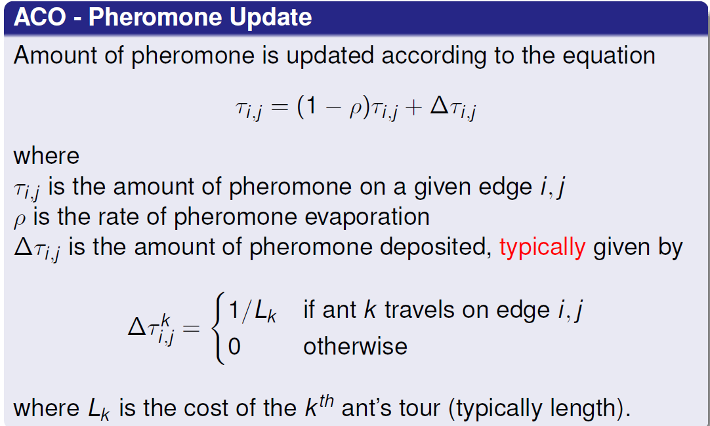
ACO

Slide 19
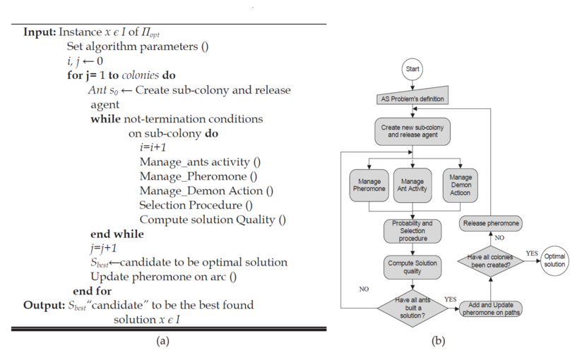
Pseudo-code And Flow chart

Slide 20
Disadvantages
Theoretical analysis is difficult
Probability distribution changes by iteration
Research is experimental rather than theoretical
Slower convergence rate.
Performed poorly for TSP problems larger than 75 cities.

Slide 21
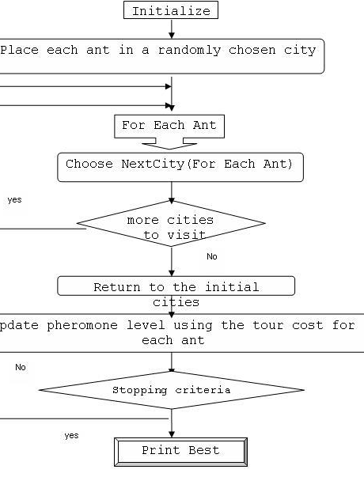
Traveling Salesman Problem

Slide 22
Application
Traveling salesman
Graph coloring
Data Mining
protein structure prediction problem
Scheduling Problem
Vehicle routing problem
Assignment problem
Set problem
Image processing

Slide 23
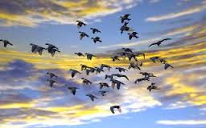
Particle Swarm Optimization

Slide 24
PSO is stochastic optimization technique proposed by Kennedy and Eberhart ( 1995) [2].
Uses a number of agents (particles) that constitute a swarm moving around in the search space looking for the best solution
Each particle in search space adjusts its “flying” according to its own flying experience as well as the flying experience of other particles
Simple algorithm, easy to implement and few parameters to adjust mainly the velocity

Slide 25
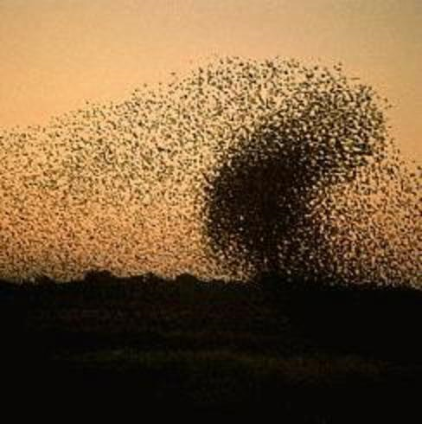
Each particle modifies its position according to:
Its current position
Its current velocity
The distance between its
current position and pbest
The distance between its current
position and gbest

Slide 26
PSO Algorithm
The PSO algorithm pseudocode [2] as following:
Input: Randomly initialized position and velocity of Particles:
Xi (0) andVi (0)
Output: Position of the approximate global minimum X*
1: while terminating condition is not reached do
2: for i = 1 to number of particles do
3: Calculate the fitness function f
4: Update personal best and global best of each particle
5: Update velocity of the particle using Equation 2
6: Update the position of the particle using equation 1
7: end for
8: end while

Slide 27
Each particle tries to modify its position X using the following formula:
X (t+1) = X(t) + V(t+1) (1)
V(t+1) = wV(t) +
c₁ ×rand ( ) × ( X_{pbest} - X(t)) + c₂ ×rand ( ) × ( X_{gbest} - X(t)) (2)
V(t) | velocity of the particle at time t
X(t) | Particle position at time t
w | Inertia weight
c₁ , c₂ | learning factor or accelerating factor
rand | uniformly distributed random number between 0 and 1
X_{pbest} | particle’s best position
X_{gbest} | global best position

Slide 28
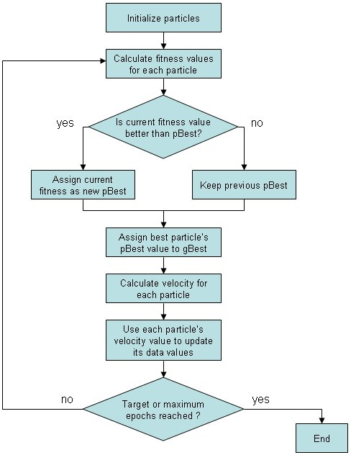

Slide 29
Number of particles usually between 10 and 50
C₁ is the importance of personal best value
C₂ is the importance of neighborhood best value
Usually C₁ + C₂ = 4 (empirically chosen value)
If velocity is too low → algorithm too slow
If velocity is too high → algorithm too unstable

Slide 30
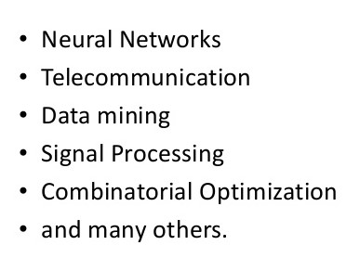
PSO APPLICATIONS

Slide 31
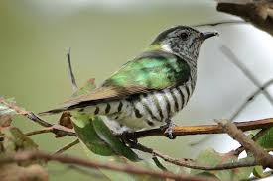
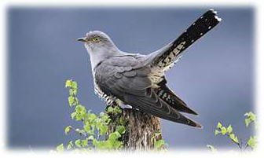
Cuckoo Search Optimization
Cuckoo search (CS) is an optimization algorithm
developed by Xin-she Yang and Suash Deb in 2009.

Slide 32
It was inspired by the obligate brood parasitism of
some cuckoo species by laying their eggs in the nests
of other host birds (of other species).
Some host birds can engage direct conflict with the intruding cuckoos. For example, if a host bird discovers the eggs are not their own, it will either throw these alien eggs away or simply abandon its nest and build a new nest elsewhere.
Some cuckoo species have evolved in such a way that the female parasitic cuckoos are often very specialized in the mimicry in colors and pattern of the eggs of a few chosen host species.

Slide 33
Three idealized rules of Cuckoo Search
Each Cuckoo lays one egg at a time , and dumps it in a randomly chosen nest;
The best nests with high quality of eggs(solutions)will carry over to the next generations;
The no. of available host nests is fixed , and a host can discover an alien egg with probability (0,1).

Slide 34
Levi Flight
In nature, animals search for food in a random manner.
Generally, the foraging path of an animal is effectively a random walk because the next move is based on both the current location/state and the transition probability to the next location
The chosen direction implicitly depends on a probability, which can be modeled mathematically
A Lévy flight is a random walk in which the step-lengths are distributed according to a heavy-tailed probability distribution.

Slide 35
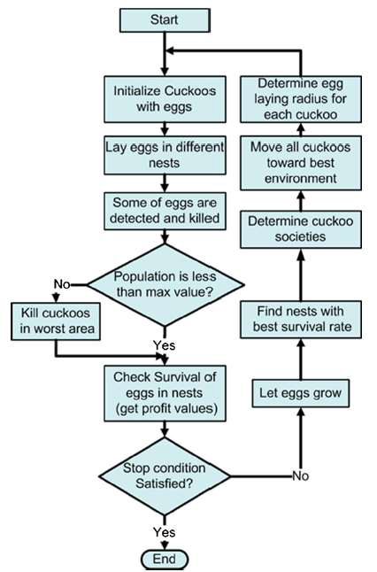

Slide 36
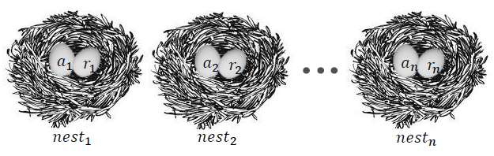
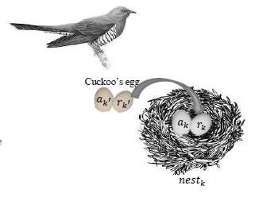
Main concepts of cuckoo search algorithm
Step2. Lay the egg (𝑎𝑘′,𝑏𝑘′) in the k nest.
• K nest is randomly selected.
• Cuckoo’s egg is very similar to host egg.
Step1. Generate initial population of n host nests
(𝑎𝑖,𝑟𝑖) : a candidate for optimal parameters
𝑎𝑘′=𝑎𝑘+𝑅𝑎𝑛𝑑𝑜𝑚𝑤𝑎𝑙𝑘(Lѐvy flight)𝑎𝑘
𝑟𝑘′=𝑟𝑘+𝑅𝑎𝑛𝑑𝑜𝑚𝑤𝑎𝑙𝑘(Lѐvy flight)𝑟𝑘

Slide 37
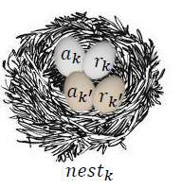
Step4. If the fitness of cuckoo’s egg is better than host egg,replace the egg in nest k by cuckoo’s egg.
Step5. If host bird notice it, the nest is abandoned and new one is built.
Step3. Compare the fitness of cuckoo’s egg with the fitness of
the host egg. Root Mean Square Error (RMSE)

Slide 38
Application of the CS Algorithm
Engineering optimization problems
NP hard combinatorial optimization problems
Data fusion in wireless sensor networks
Nanoelectronic technology based operation-amplifier
(OP-AMP)
Train neural network
Manufacturing scheduling
Nurse scheduling problem

Slide 39
Artificial Bee Colony
Defined algorithms by Dervis Karaboga in 2005, motivated by the intelligent behavior of honey bees.
ABC as an optimization tool provides a population-based search procedure in which individuals called foods positions are modified by the artificial bees with time and the bee’s aim is to discover the places of food sources with high nectar amount and finally the one with the highest nectar.
It based on the foraging behavior of honey bee colonies.

Slide 40
Bee system consists of two essential components
Food Sources
The artificial bee colony contains three groups:
→Scouts
→Onlookers
→Employed bees

Slide 41
•An employed bee produces a modification on the position (solution) her memory depending on the nectar amount (fitness value) of the new source.
Provided that the nectar amount of the new one is higher than that of the previous one, the bee memorizes the new position and forgets the old one.
After all employed bees complete the search process, they share the nectar information of the food sources and their position information with the onlooker bees on the dance area.
An onlooker bee evaluates the nectar information taken from all employed bees and chooses a food source with a probability related to its nectar amount

Slide 42

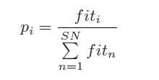
In order to produce a candidate food
position from the old one in memory,
the ABC uses the following expression
An artificial onlooker bee chooses a
food source depending on the
probability value associated with that
food source, pi ,
where k ∈ {1, 2,..., SN} and j ∈ {1, 2,...,D}
are randomly chosen indexes.
k is determined randomly, it has to be
different from i.
φi,j is a random number between [-1, 1].
fiti is the fitness value of the
solution i
SN is the number of food
sources which is equal to the
number of employed bees (BN).

Slide 43
Application of ABC
Neural Network Training
Image Processing Applications.
TSP.
Graph coloring.
Solving Sudoku.

Slide 44
Thank You!

